Slide 1
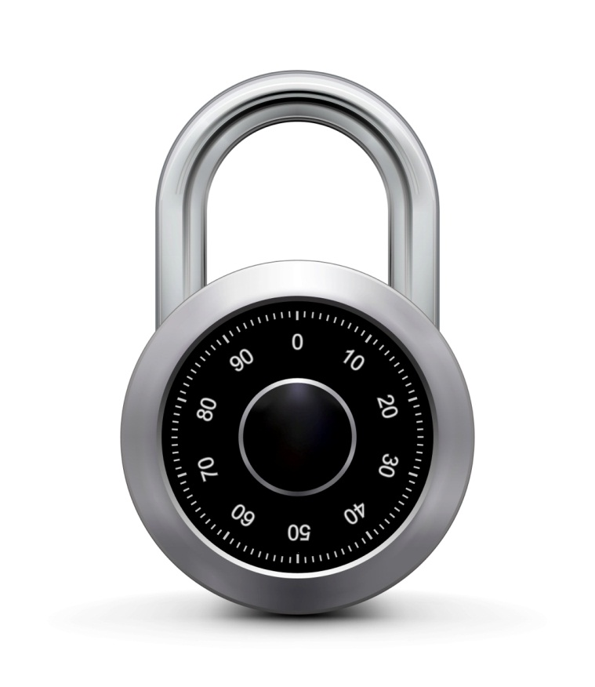
Attacks on OTP and stream ciphers
Online Cryptography Course Dan Boneh
Stream ciphers

Slide 2
Review
OTP: E(k,m) = m ⊕ k , D(k,c) = c ⊕ k
Making OTP practical using a PRG: G: K ⟶ {0,1}^{n}
Stream cipher: E(k,m) = m ⊕ G(k) , D(k,c) = c ⊕ G(k)
Security: PRG must be unpredictable (better def in two segments)

Slide 3
Attack 1: two time pad is insecure !!
Never use stream cipher key more than once !!
C₁ ← m₁ ⊕ PRG(k)
C₂ ← m₂ ⊕ PRG(k)
Eavesdropper does:
C₁ ⊕ C₂ → m₁ ⊕ m₂
Enough redundancy in English and ASCII encoding that:
m₁ ⊕ m₂ → m₁ , m₂

Slide 4
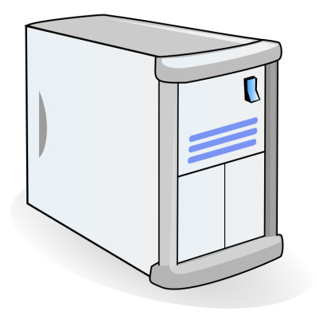
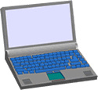
Real world examples
Project Venona
MS-PPTP (windows NT):
k
k
Need different keys for C⟶S and S⟶C
Notes:
Venona: soviet messages sent from 1941 to 1946, decrypted about 3000 messages.

Slide 5
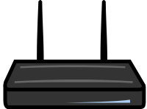
Real world examples
802.11b WEP:
Length of IV: 24 bits
Repeated IV after 2²⁴ ≈ 16M frames
On some 802.11 cards: IV resets to 0 after power cycle
m
CRC(m)
k
PRG( IV ll k )
k
IV
ciphetext

Slide 6
Avoid related keys
802.11b WEP:
key for frame #1: (1 ll k)
key for frame #2: (2 ll k)
m
CRC(m)
k
PRG( IV ll k )
k
IV
ciphetext
⋮

Slide 7
A better construction
k
PRG
k
⇒ now each frame has a pseudorandom key
better solution: use stronger encryption method (as in WPA2)

Slide 8
Yet another example: disk encryption

Slide 9
Two time pad: summary
Never use stream cipher key more than once !!
Network traffic: negotiate new key for every session (e.g. TLS)
Disk encryption: typically do not use a stream cipher

Slide 10
Attack 2: no integrity (OTP is malleable)
enc ( ⊕k )
m
m⊕k
⊕
p
dec ( ⊕k )
m⊕p
(m⊕k)⊕p
Modifications to ciphertext are undetected and have predictable impact on plaintext

Slide 11
Attack 2: no integrity (OTP is malleable)
enc ( ⊕k )
From: Bob
From: Bob
⊕
⋯
dec ( ⊕k )
From: Eve
From: Eve
Modifications to ciphertext are undetected and have predictable impact on plaintext
Notes:
Bob: 42 6F 62 , Eve: 45 76 65 , Bob ⊕ Eve: 07 19 07

Slide 12
End of Segment

